Slide 1


Medical Insurance Premium prediction
M.Sc. Statistics
Chavi

Slide 2

Abstract:
The study explores the use of machine learning techniques to forecast medical insurance premiums, aiming to predict the most expensive expenses for patients.
Using a comprehensive dataset, the research employs various machine learning algorithms to analyze demographic information, medical history, lifestyle factors, and insurance coverage details.

Slide 3

Objective:
The objective of the project is to build a Machine Learning model to forecast annual medical insurance premium based on given customer data.

Slide 4

content
Introduction 5
Literature review 8
History and background 12
Dataset overview 15
Data preprocessing 16
Exploratory data analysis 17
Multicollinearity check & Significance test 23
Machine learning algorithms 29
Conclusion 36
Summary 37

Slide 5

Medical Insurance
Medical insurance is an insurance product that covers medical and surgical expenses of whole or part of an insured individual.
Medical insurance is a contract between the insurer and the insured. It offers coverage for expenses against medical and surgical treatments to the policyholder.
The policy covers your in-hospitalization and pre-and post-hospitalization expenses up to a pre-determined amount.​

Slide 6





Types of medical insurance:
Individual health insurance
family float health insurance
senior citizen health insurance
critical illness insurance
Group insurance

Slide 7




BENEFITS:
Protection
ACCESS
Protection against unexpected medical expenses
Access to quality health care service
Cost savings
Incentive
Tax benefits
Incentive for maintaining healthy lifestyle.

Slide 8

Literature Review:

Slide 9

A. Khalfan , Hassan & M.S. Ansari
Research
Machine Learning Techniques For Predicting Insurance Premiums
Abstract
This study investigates various machine learning models for predicting insurance premiums, Gradient Boosting and Neural Networks. It discusses feature selection methods and model evaluation techniques to optimize prediction accuracy
“Machine Learning Techniques For Predicting Insurance Premiums”
By A. Khalfan , Hassan and M.S Ansari
Link:https://www.researchgate.net/publication/380723716_MEDICAL_INSURANCE_PREMIUM_PREDICTION_WITH_MACHINE_LEARNING

Slide 10
R. S. Raj & S. Kumar
Research
Deep Learning Approaches for Health Insurance Premium Prediction
Abstract
This paper explores the application of deep learning techniques, including Convolution Neural Network and Recurrent Neural Networks, for health insurance premium prediction. It discusses of using deep learning
models in this context.
“Deep Learning Approaches for Health Insurance Premium Prediction” by R. S. Raj and S. Kumar
https://ijsrset.com/paper/11908.pdf

Slide 11
S. Gupta & S. Sharma
Research
Predicting Health Insurance Premiums: A Comparative Study of Machine Learning Techniques
Abstract
This research compares the effectiveness of machine learning algorithms such KNN, Naïve Bayes , and Ensemble methods in predicting health insurance premiums. It analyzes the impact of different features sets and preprocessing techniques on prediction performance.
“Predicting Health Insurance Premiums : A Comparatives Study of Machine Learning Techniques” by S. Gupta and S. Sharma
https://repo.ijiert.org/index.php/ijiert/article/view/3891/3288

Slide 12

History & Background:
Medical insurance was launched in 1986, the medical insurance industry has grown significantly mainly due to the liberalization of the economy and general awareness. According to the World Bank, by 2010, more than 25% of India's population had access to some form of medical insurance.
Health insurance in India is a growing segment of India's economy. The Indian healthcare system is one of the largest in the world, with the number of people it concerns: nearly 1.3 billion potential beneficiaries. The healthcare industry in India has rapidly become one of the most important sectors in the country in terms of income and job creation. In 2018, one hundred million Indian households (500 million people) benefited from health coverage. In 2011, 3.9% of India's gross domestic product was spent in the health sector.

Slide 13
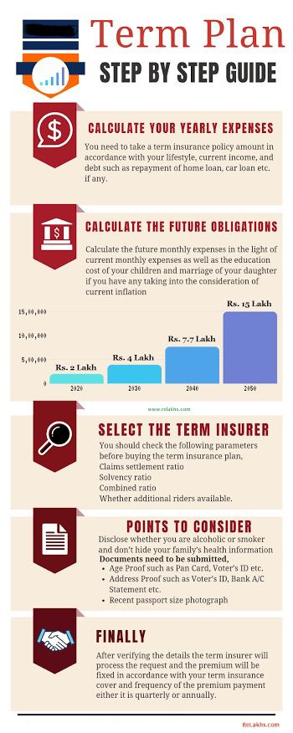
Policies are available that offer both individual and family coverage. Out of this 3.9%, health insurance accounts for 5-10% of expenditure, employers account for around 9% while personal expenditure amounts to an astounding 82%. In the year 2016, the NSSO released the report "Key Indicators of Social Consumption in India: Health" based on its 71st round of surveys. The survey carried out in the year 2014 found that more than 80% of Indians are not covered under any health insurance plan, and only 18% (government-funded 12%) of the urban population and 14% (government-funded 13%) of the rural population were covered under any form of health insurance.
There are standalone health insurers along with government-sponsored health insurance providers. Recently, to improve awareness and reduce procrastination in buying health insurance, the General Insurance Corporation of India and the Insurance Regulatory and Development Authority (IRDAI) launched an awareness campaign for all segments of the population.

Slide 14
Data preprocessing:

Slide 15
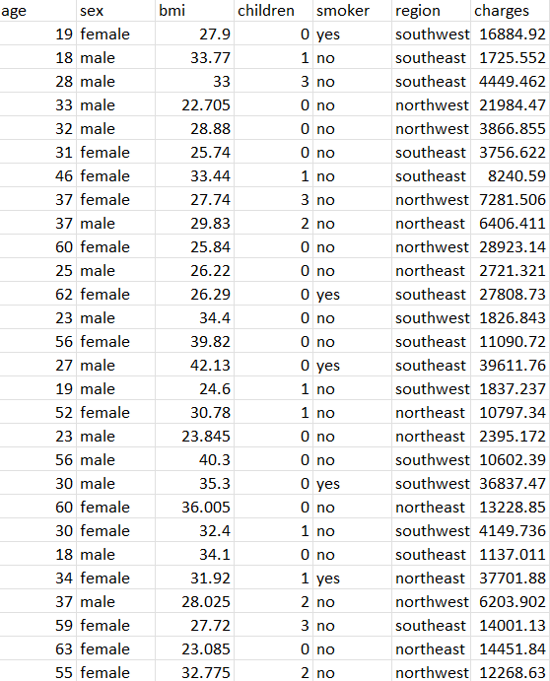
dataset overview
Source:
The dataset (secondary data) was extracted from Kaggle.
https://www.kaggle.com/datasets/noordeen/insurance-premium-prediction
About:
ACME Insurance Inc. offers affordable health insurance to thousands of customer all over the United States. You're tasked with creating an automated system to estimate the annual medical expenditure for new customers, using information such as their age, sex, BMI, children, smoking habits and region of residence. Estimates from your system will be used to determine the annual insurance premium (amount paid every month) offered to the customer.
Variables:
The dataset has 7 variables, namely, Age, Sex, BMI, Children, Smoker, Region and Charges. We have the data of 1338 individuals who have taken medical insurance.

Slide 16
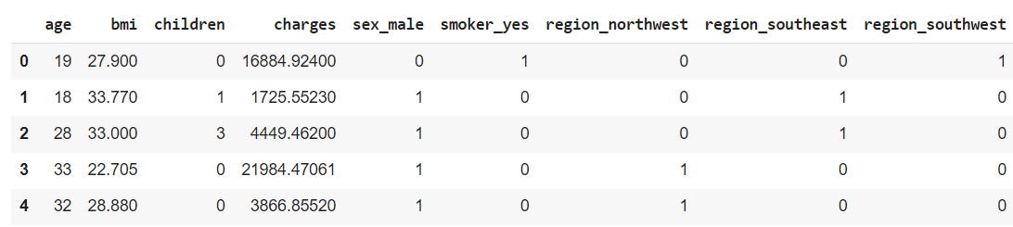
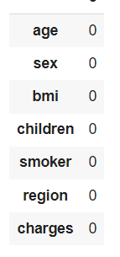
Data preprocessing:
The categorical variables namely sex, smoker and region were converted into numerical form using dummy variables.
Under dummy variables, the region variable was converted into 3 variables based on the dataset.
The dataset was checked for missing values and was observed to have no missing values.
Refer to Appendix page 45

Slide 17
Exploratory data analysis

Slide 18
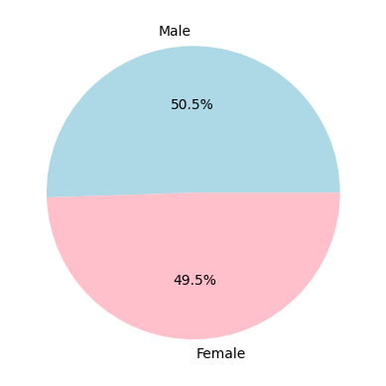
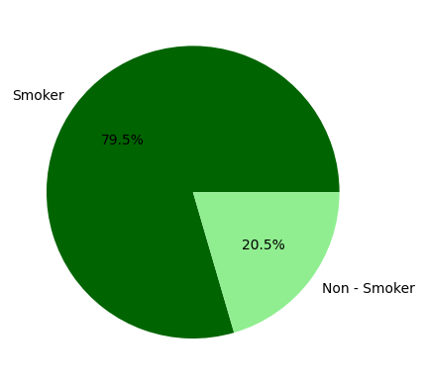
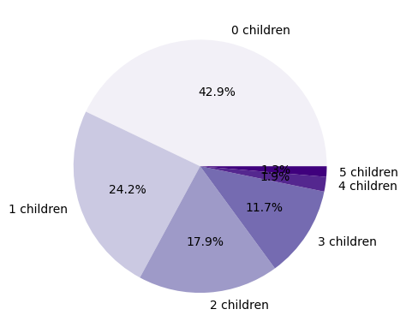
PIE charts:
The sex ratio in the dataset is almost equal
The ratio of smokers is higher than the ratio of non – smokers in the dataset
The dataset shows that around 85% of the insured are having less than 3 children

Slide 19
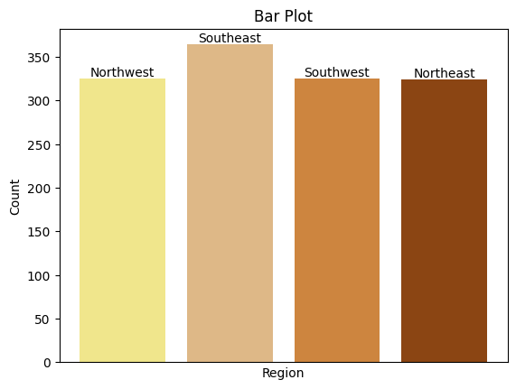
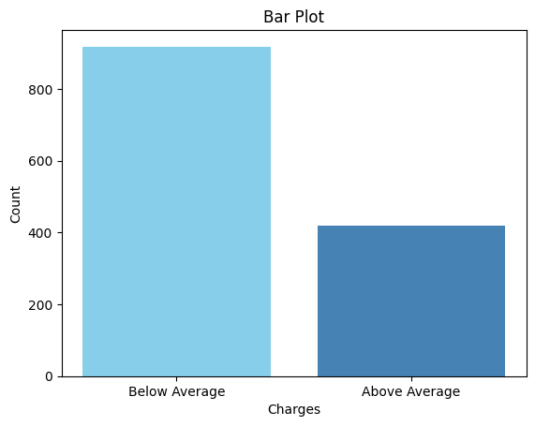
Bar plots:
The insured belonging to the Southeast region is slightly higher than the other regions in the dataset.
The insured being charged below average premium is more than that of the insured being charged above average premium depicting positively skewed data.

Slide 20
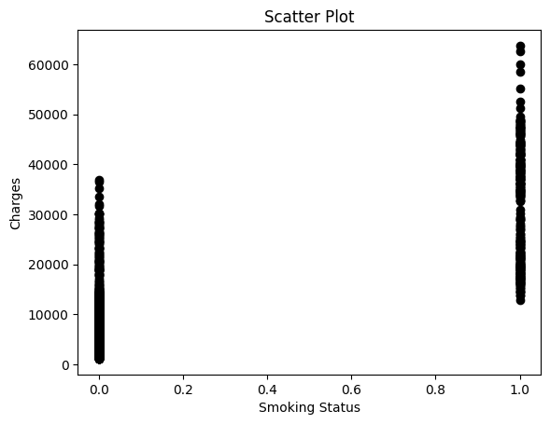
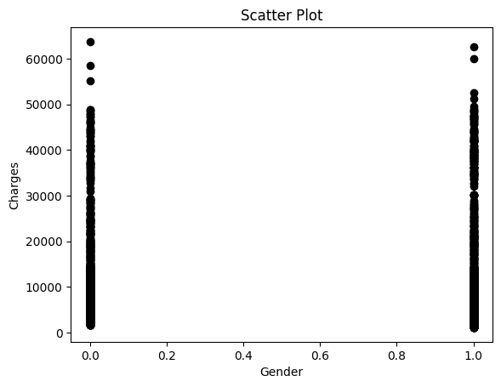
scatter plots:
The premium charged for smokers is higher than the premium charged for non–smokers.
The premium charged for males and females are almost equal showing that premium charged is not affected by gender.

Slide 21
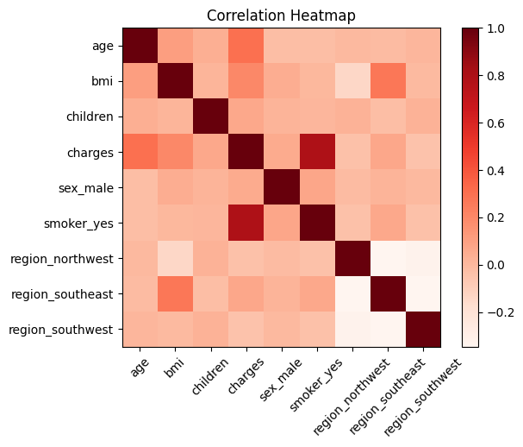
Correlation matrix
There is high positive correlation between charges and smoker_yes variables.

Slide 22
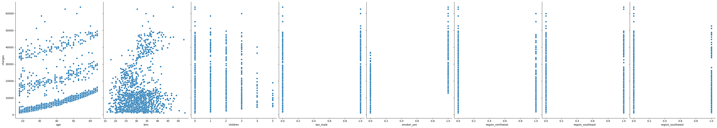
Pair plot:
The pair plot shows charges on the y-axis and all the other variables on the x-axis.

Slide 23
Multicollinearity & Significance check:

Slide 24
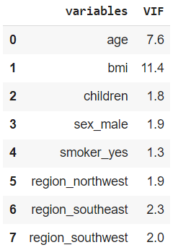
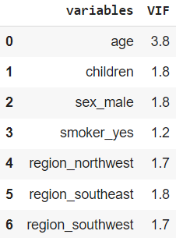
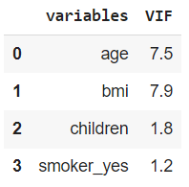
Multicollinearity check:
BMI VIF score is greater than 10.
All the VIF scores are below 10
All the VIF scores are below 10 after removing insignificance
Refer to Appendix page 48

Slide 25
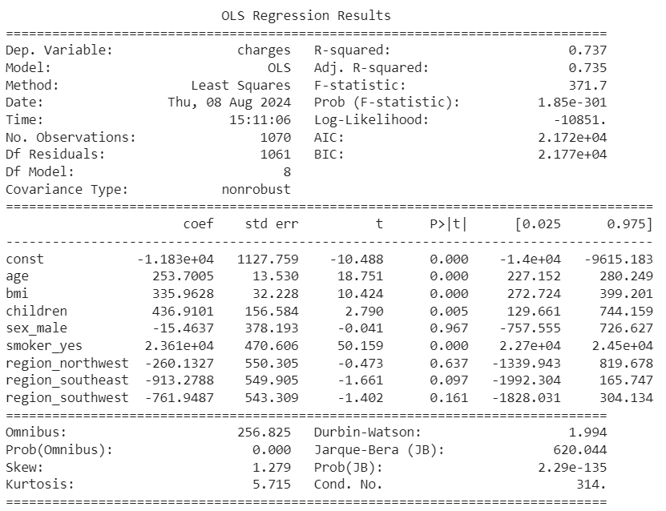
Significance test
MODEL 1 (Complete Dataset)
The variables sex_male, region_northwest, region_southeast and region_southwest have p value greater than 5% for the complete dataset.

Slide 26
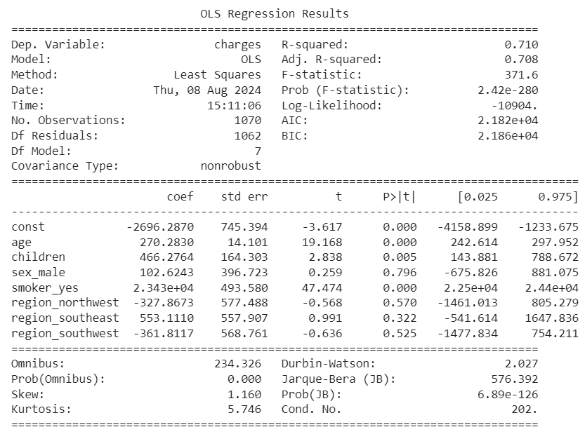
Significance test
MODEL 2 (Data after removing Multicollinearity)
The variables sex_male, region_northwest, region_southeast and region_southwest have p-value greater than 5%. The multicollinear variable has been removed and the R squared value has dropped.

Slide 27
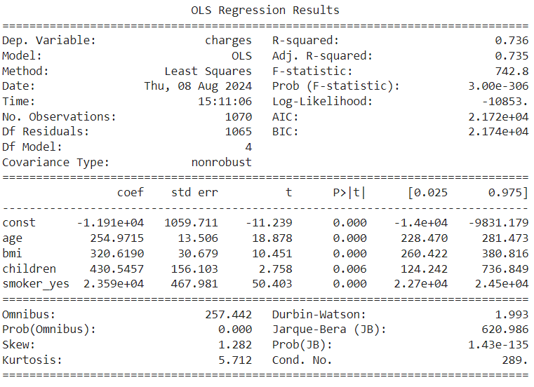
Significance test
MODEL 3 (Data after removing Insignificant Variables)
All the variables are having p-value below 5% including the BMI variable.

Slide 28
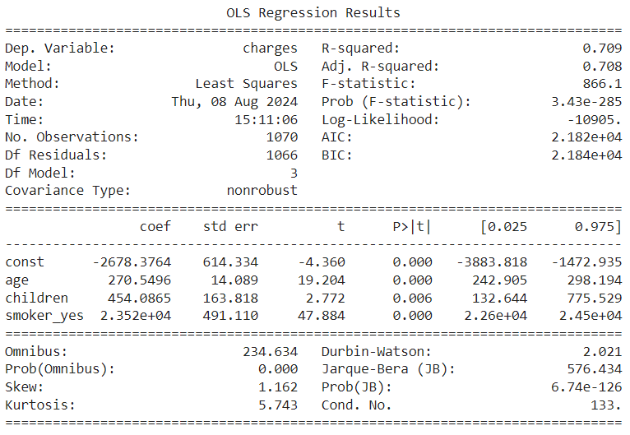
Significance test
MODEL 4 (Data after removing Multicollinearity & Insignificant Variables)
All variables are having p value below 5%
Refer to Appendix pg. 49

Slide 29
Machine learning algorithms

Slide 30

Analysis:
MODELS | Meaning
Model 1 | Complete dataset
Model 2 | Data after removing Multicollinearity
Model 3 | Data after removing Insignificant Variables
Model 4 | Data after removing Multicollinearity & Insignificant Variables
SPLITTING RATIOS (TRAIN : TEST)
60:40, 70:30, 75:25, 80:20, 90:10
MACHINE LEARNING ALGORITHMS:
Multiple Linear Regression | Decision Tree Regressor
K Nearest Neighbor | Random Forest Regressor
Support Vector Machine (Regressor) | Bagging on Decision Tree Regressor

Slide 31
60 : 40 train - test split Ratio
ML Algorithm: | Model 1 | Model 2 | Model 3 | Model 4
Linear Regression | 0.74 6135.87 | 0.70 6524.69 | 0.74 6130.19 | 0.70 6514.23
KNN | 0.07 11582.53 | 0.31 9938.22 | 0.02 11845.11 | 0.48 8686.53
SVM Regressor | -0.17 12960.35 | -0.167 12952.64 | -0.169 12963.70 | -0.167 12956.69
Decision Tree Regressor | 0.66 7041.94 | 0.38 9426.84 | 0.67 6929.59 | 0.51 8417.39
Random Forest Regressor | 0.83 4980.66 | 0.62 7387.52 | 0.82 5116.41 | 0.60 7608.54
Bagging | 0.82 5154.70 | 0.61 7510.15 | 0.83 4928.13 | 0.60 7574.18
Model 1 – Complete dataset
Model 2 – Removing Multicollinearity
Model 3 – Removing Insignificant Variables
Model 4 – Removing both Multicollinearity & Insignificant Variables
R Squared Values
Root Mean Square Error Values

Slide 32
70 : 30 train - test split Ratio
ML Algorithm: | Model 1 | Model 2 | Model 3 | Model 4
Linear Regression | 0.74 6063.12 | 0.707 6443.53 | 0.74 6079.47 | 0.706 6455.40
KNN | 0.14 11037.96 | 0.35 9619.63 | 0.13 11115.54 | 0.48 8554.57
SVM Regressor | -0.12 12619.18 | -0.123 12646.79 | -0.1227 12613.94 | -0.1232 12616.30
Decision Tree Regressor | 0.68 6765.89 | 0.35 9625.27 | 0.63 7248.04 | 0.51 8317.44
Random Forest Regressor | 0.83 4922.84 | 0.56 7852.98 | 0.82 5014.81 | 0.59 7621.20
Bagging | 0.83 4931.72 | 0.56 7861.64 | 0.83 4854.19 | 0.59 7596.40
Model 1 – Complete dataset
Model 2 – Removing Multicollinearity
Model 3 – Removing Insignificant Variables
Model 4 – Removing both Multicollinearity & Insignificant Variables
R Squared Values
Root Mean Square Error Values

Slide 33
75 : 25 train - test split Ratio
ML Algorithm: | Model 1 | Model 2 | Model 3 | Model 4
Linear Regression | 0.73 5982.56 | 0.70 6373.60 | 0.73 6005.93 | 0.699 6385.05
KNN | 0.15 10677.08 | 0.37 9195.89 | 0.17 10558.89 | 0.47 8416.19
SVM Regressor | -0.0881 12098.66 | -0.09 12100.85 | -0.088 12100.75 | -0.0889 12103.07
Decision Tree Regressor | 0.66 6758.38 | 0.36 9277.69 | 0.66 6796.13 | 0.51 8114.06
Random Forest Regressor | 0.82 4925.91 | 0.55 7777.17 | 0.81 5006.89 | 0.56 7661.84
Bagging | 0.82 4946.53 | 0.58 7477.92 | 0.82 4898.67 | 0.57 7581.01
Model 1 – Complete dataset
Model 2 – Removing Multicollinearity
Model 3 – Removing Insignificant Variables
Model 4 – Removing both Multicollinearity & Insignificant Variables
R Squared Values
Root Mean Square Error Values

Slide 34
80 : 20 train - test split Ratio
ML Algorithm: | Model 1 | Model 2 | Model 3 | Model 4
Linear Regression | 0.762 5956.45 | 0.727 6383.51 | 0.761 5970.76 | 0.725 6400.02
KNN | 0.17 11130.46 | 0.37 9665.30 | 0.18 11087.03 | 0.50 8659.96
SVM Regressor | -0.13 13013.09 | -0.132 12997.11 | -0.133 13004.88 | -0.13 12989.05
Decision Tree Regressor | 0.77 5916.54 | 0.42 9329.92 | 0.63 6681.99 | 0.54 8254.34
Random Forest Regressor | 0.85 4775.07 | 0.60 7729.89 | 0.85 4791.28 | 0.61 7669.70
Bagging | 0.84 4861.84 | 0.63 7416.43 | 0.86 4644.01 | 0.62 7573.42
Model 1 – Complete dataset
Model 2 – Removing Multicollinearity
Model 3 – Removing Insignificant Variables
Model 4 – Removing both Multicollinearity & Insignificant Variables
R Squared Values
Root Mean Square Error Values

Slide 35
90 : 10 train - test split Ratio
ML Algorithm: | Model 1 | Model 2 | Model 3 | Model 4
Linear Regression | 0.727 6565.38 | 0.689 7004.28 | 0.725 6588.75 | 0.687 7024.01
KNN | 0.06 12167.61 | 0.26 10835.84 | 0.09 12005.97 | 0.45 9295.01
SVM Regressor | -0.31 14422.25 | -0.31 14414.25 | -0.32 14422.24 | -0.32 14417.05
Decision Tree Regressor | 0.74 6389.89 | 0.37 10003.52 | 0.71 6790.11 | 0.43 9453.64
Random Forest Regressor | 0.84 5028.52 | 0.53 8595.99 | 0.83 5139.71 | 0.52 8674.63
Bagging | 0.82 5372.01 | 0.56 8347.84 | 0.84 5088.65 | 0.53 8644.75
Model 1 – Complete dataset
Model 2 – Removing Multicollinearity
Model 3 – Removing Insignificant Variables
Model 4 – Removing both Multicollinearity & Insignificant Variables
R Squared Values
Root Mean Square Error Values

Slide 36
Algorithm comparison
ML Algorithm: | 60 : 40 | 70 : 30 | 75 : 25 | 80 : 20 | 90 : 10
Linear Regression | 0.74 6130.19 | 0.74 6079.47 | 0.73 6005.93 | 0.761 5970.76 | 0.725 6588.75
KNN | 0.02 11845.11 | 0.13 11115.54 | 0.17 10558.89 | 0.18 11087.03 | 0.09 12005.97
SVM Regressor | -0.169 12963.70 | -0.1227 12613.94 | -0.088 12100.75 | -0.133 13004.88 | -0.32 14422.24
Decision Tree Regressor | 0.67 6929.59 | 0.63 7248.04 | 0.66 6796.13 | 0.63 6681.99 | 0.71 6790.11
Random Forest Regressor | 0.82 5116.41 | 0.82 5014.81 | 0.81 5006.89 | 0.85 4791.28 | 0.83 5139.71
Bagging | 0.83 4928.13 | 0.83 4854.19 | 0.82 4898.67 | 0.86 4644.01 | 0.84 5088.65
R Squared Values
Root Mean Square Error Values

Slide 37

conclusion
Based on our dataset, we observed that Model 3 that is the model with only significant variables has been giving high R squared values with low Root mean square error.
The highest R squared value with a low Root mean square error was observed while using the Decision Tree Algorithm after Bagging.
Hence, we can conclude that the best model that can forecast annual medical insurance premiums based on the data is Model 3 using Decision Tree Regressor Algorithm after Bagging using 80:20 train-test split ratio.

Slide 38
summary
Machine learning may increase the efficiency, fairness, and accuracy of the insurance industry by creating prediction models and evaluating historical data. However, challenges include ensuring fairness, transparency, mitigating bias, and maintaining model interpretability. Despite these, advancements in machine learning techniques and a deeper understanding of insurance dynamics are paving the way for more understanding.

Slide 39

Thank you
Chavi Boob
MSc. Statistics

Slide 40
Appendix

Slide 41
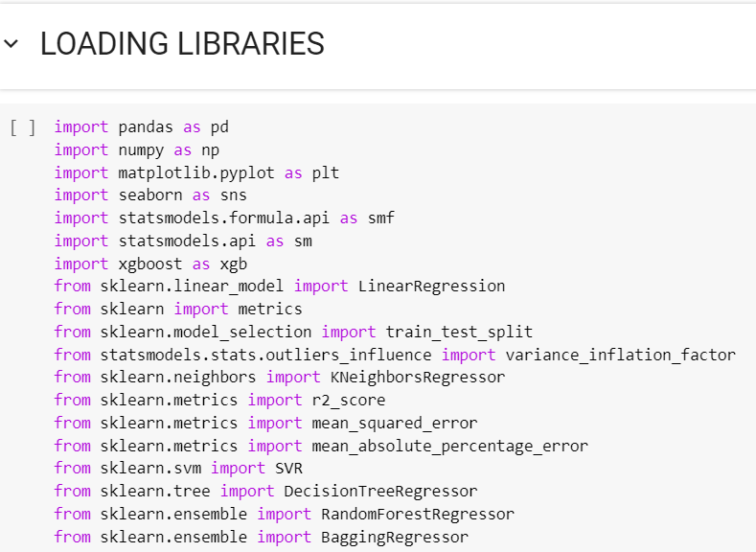

Slide 42
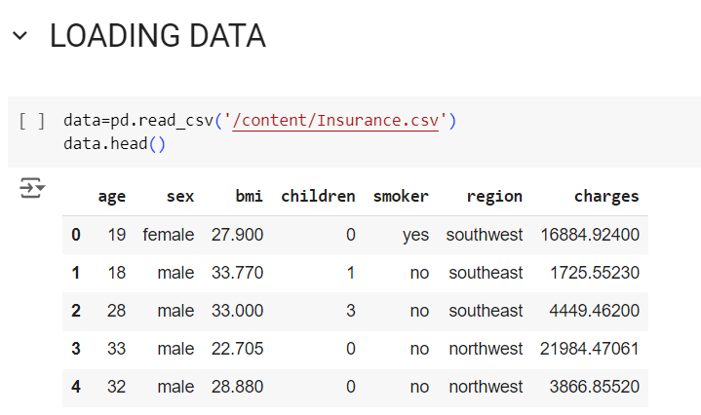
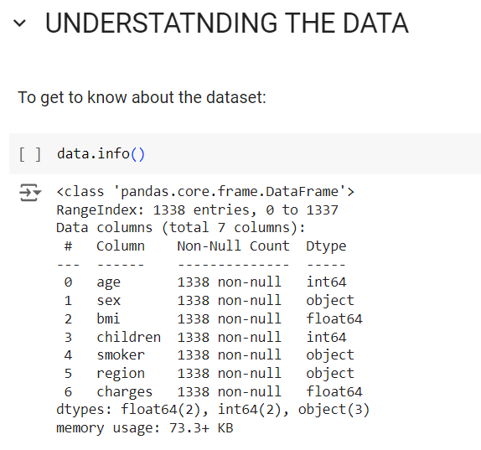

Slide 43
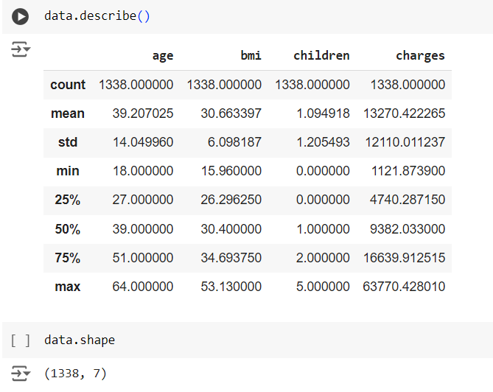
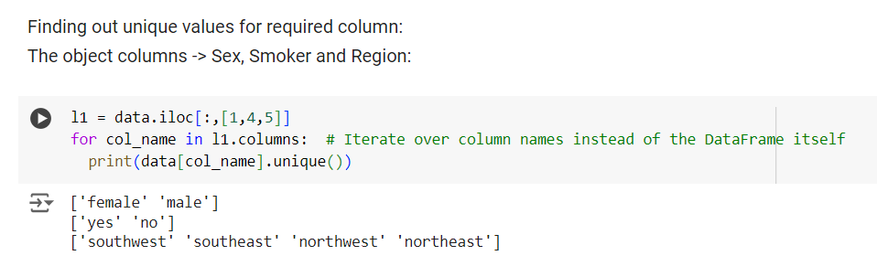

Slide 44
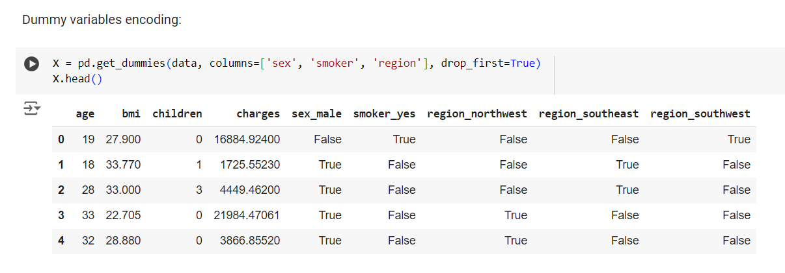

Slide 45
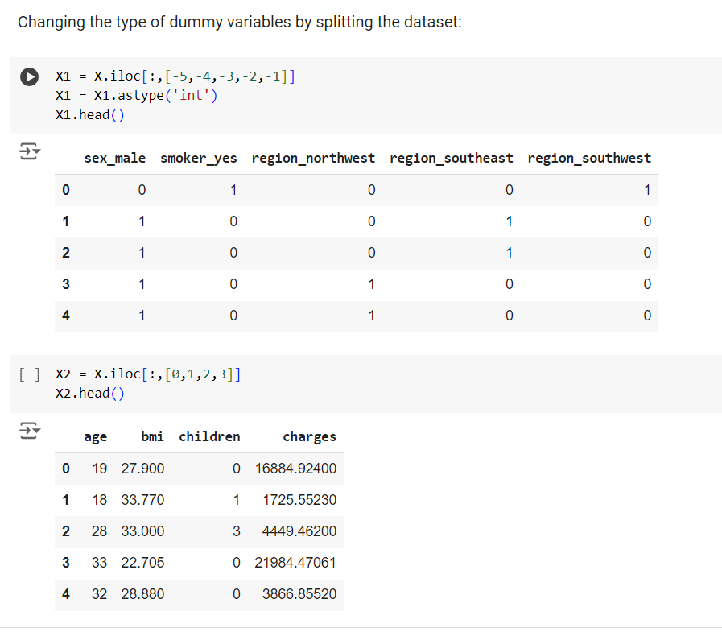

Slide 46
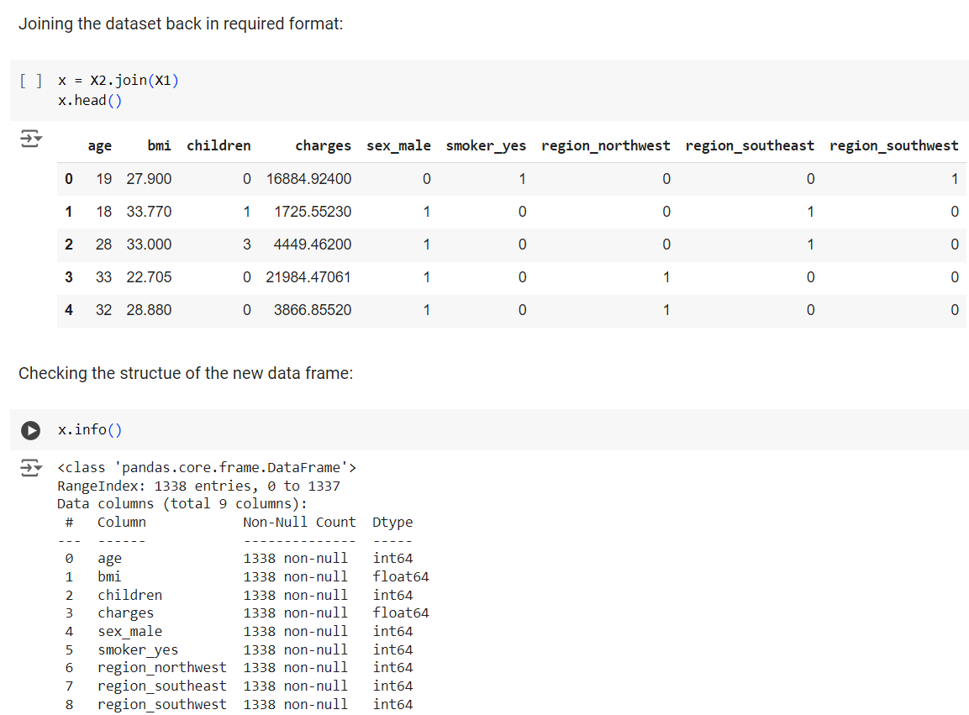

Slide 47
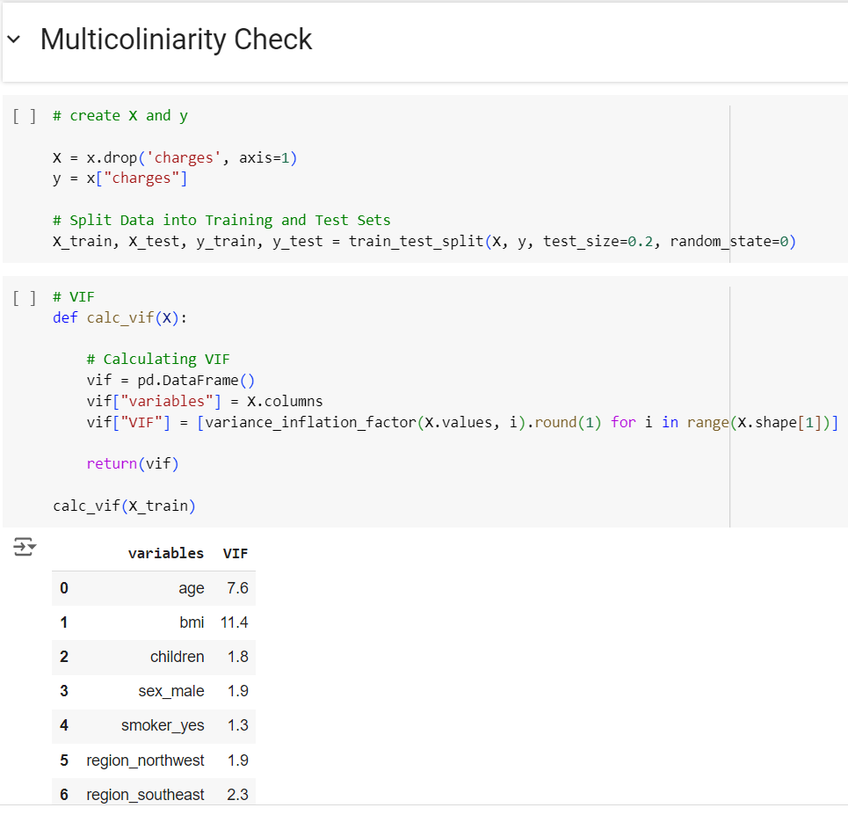
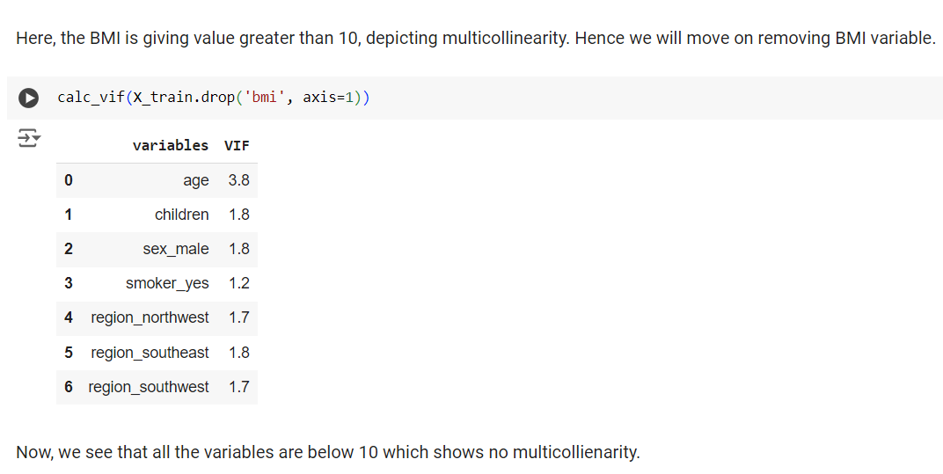

Slide 48
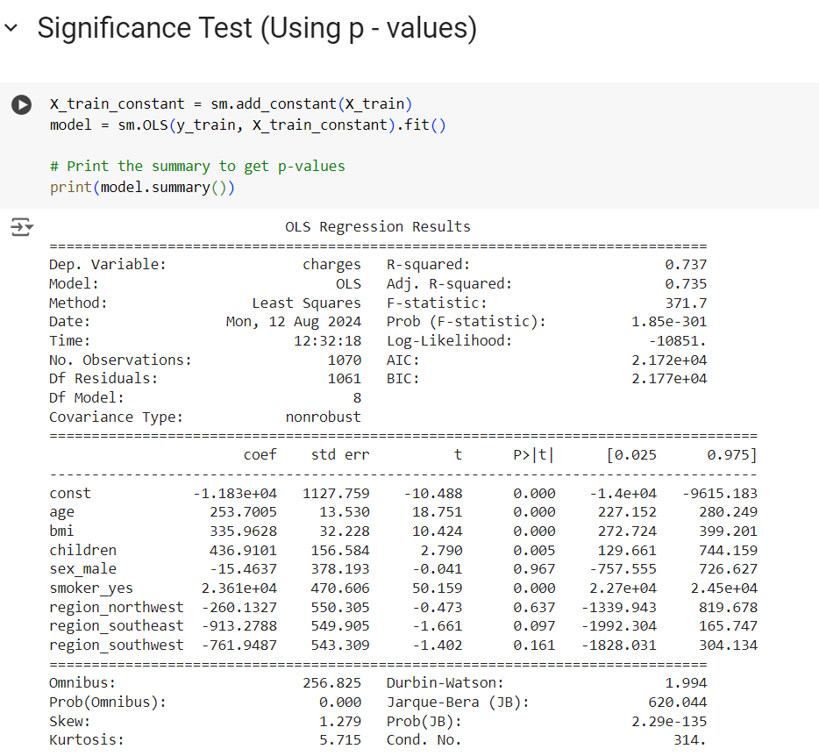
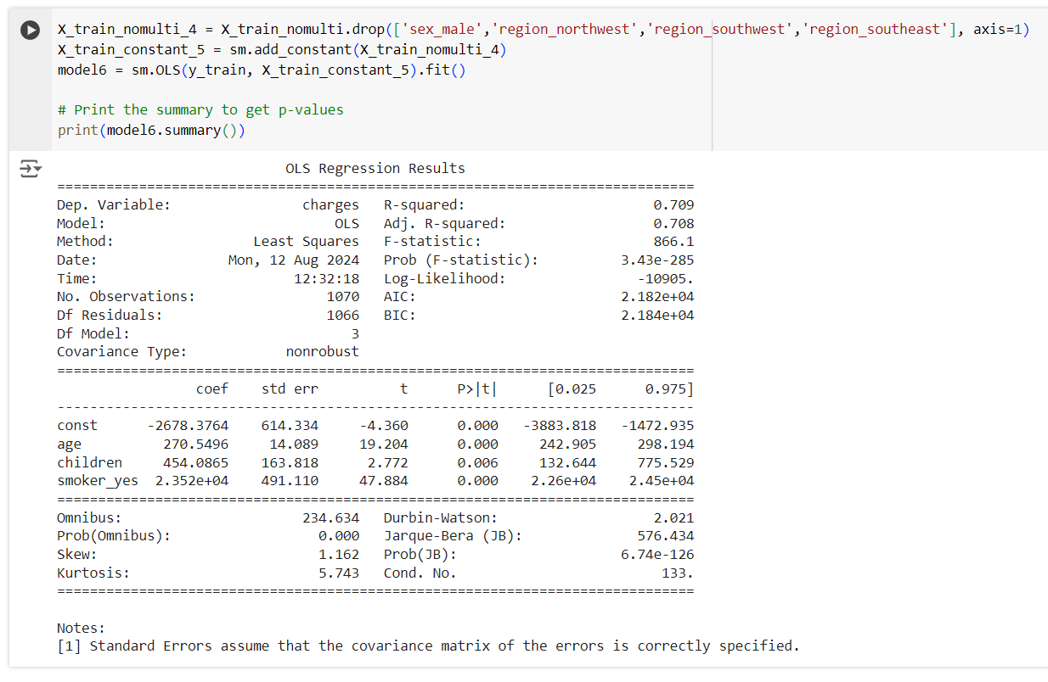

Slide 49
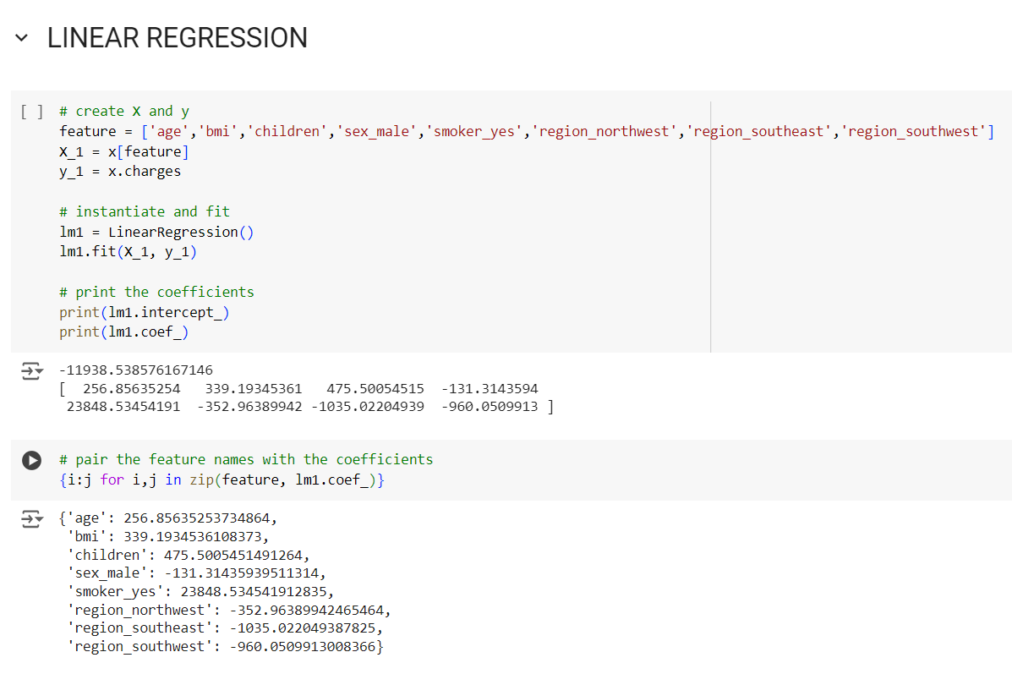

Slide 50
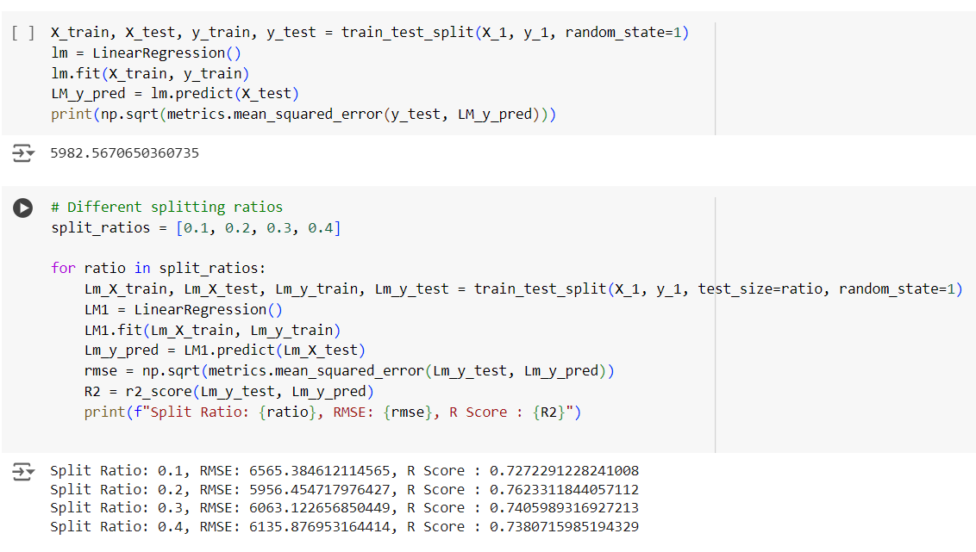

Slide 51
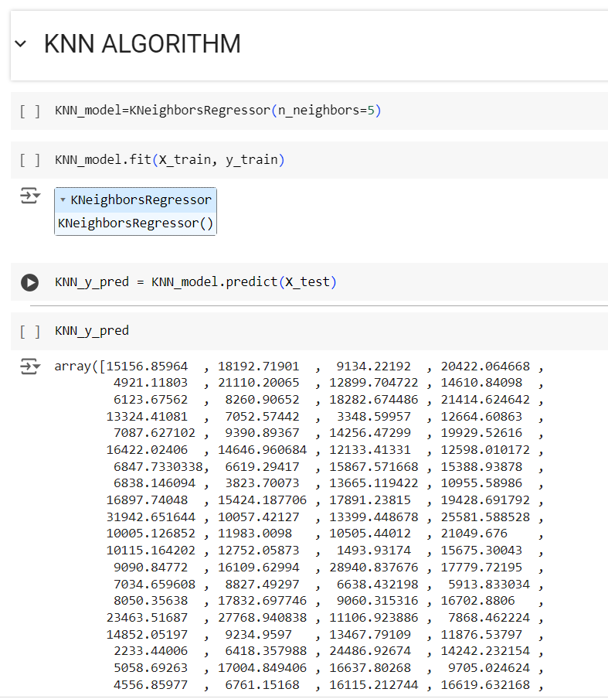
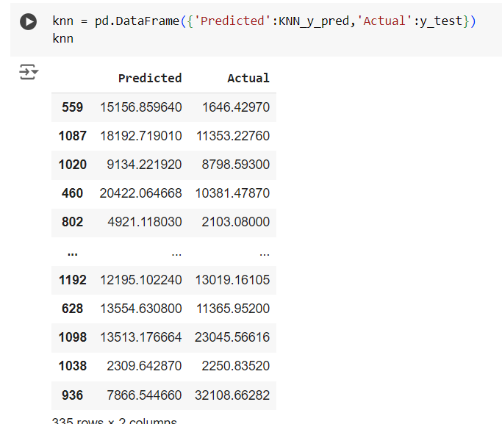

Slide 52
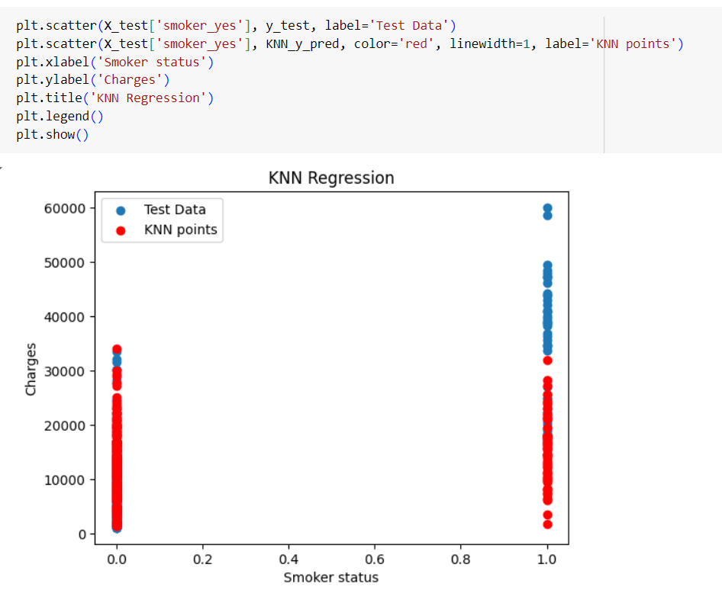
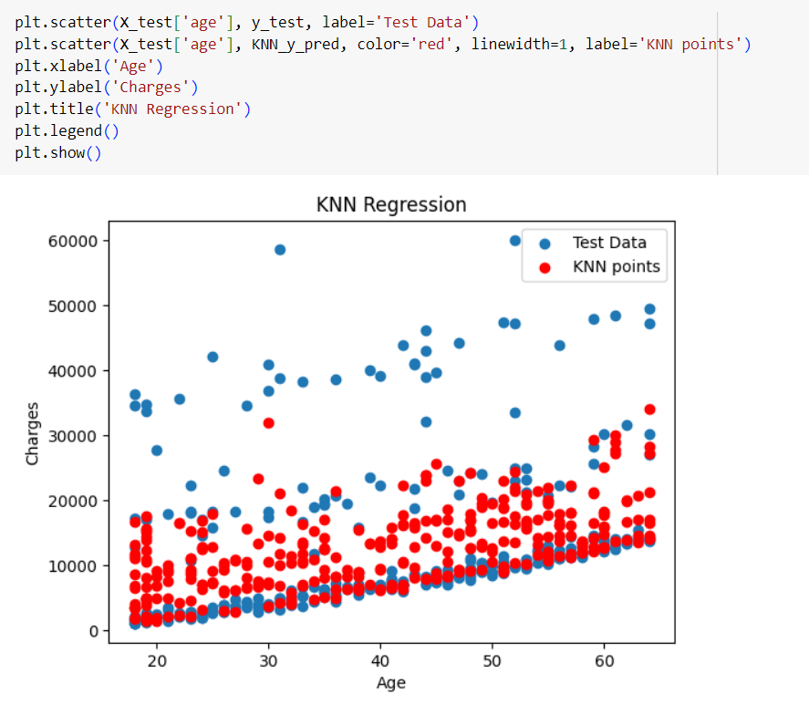

Slide 53
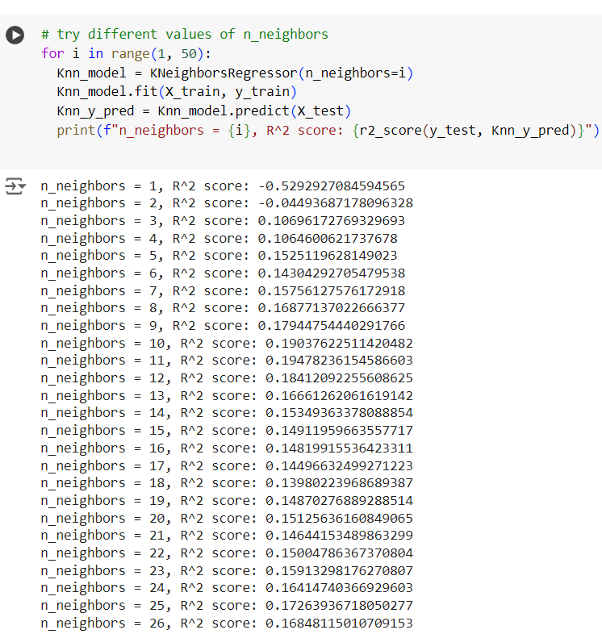
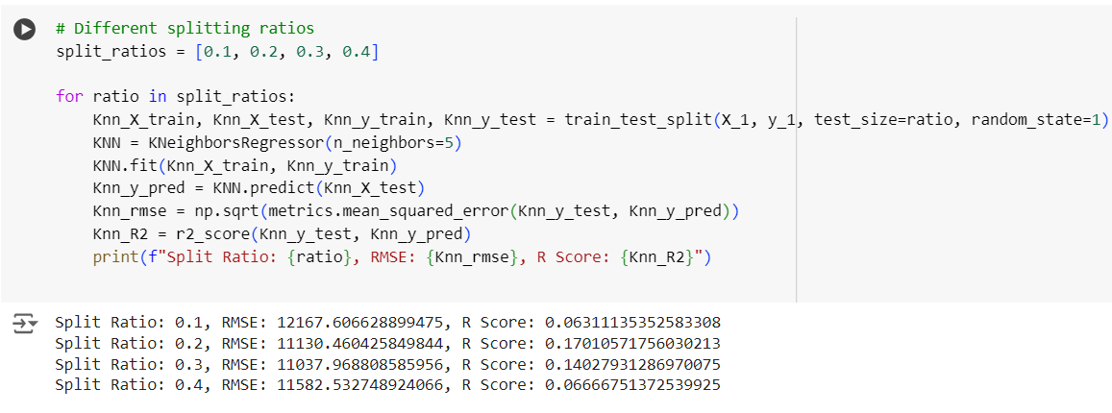

Slide 54
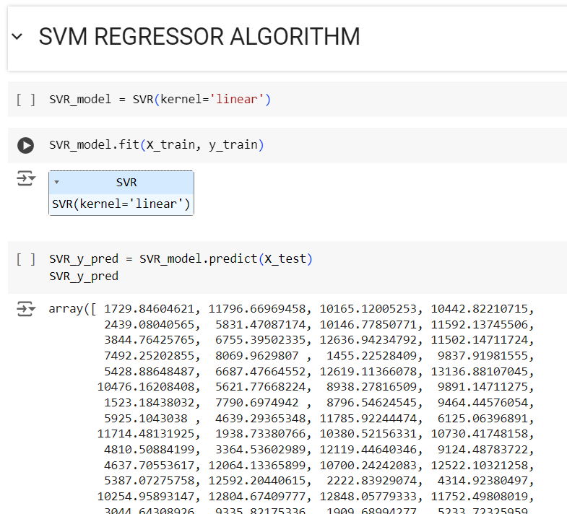
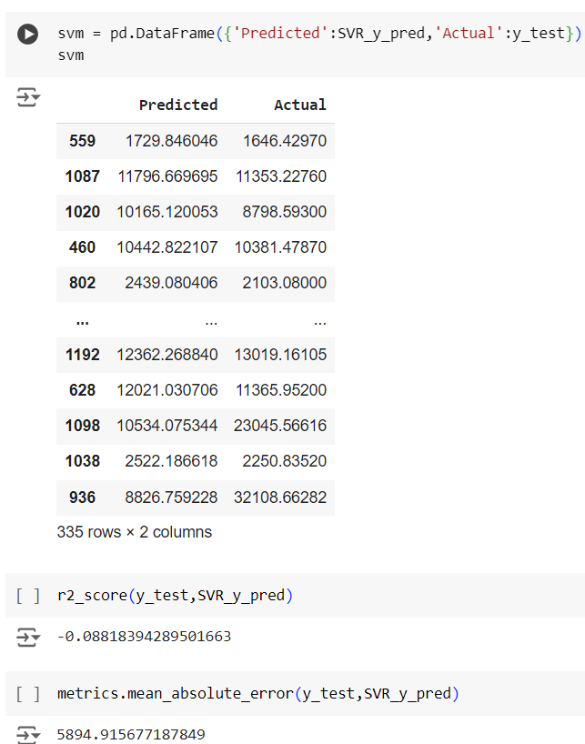

Slide 55
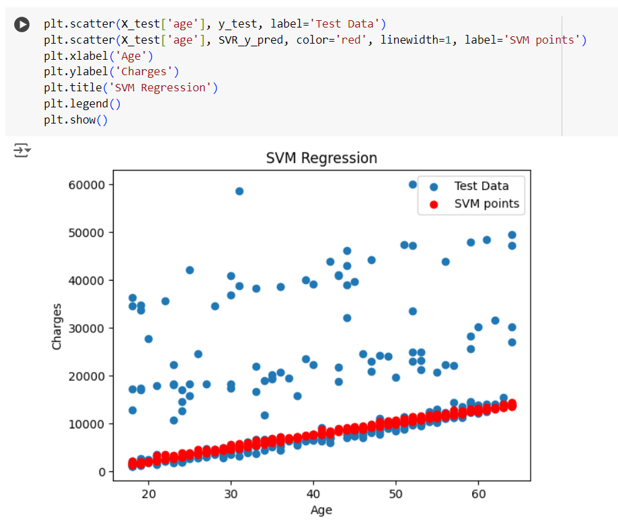
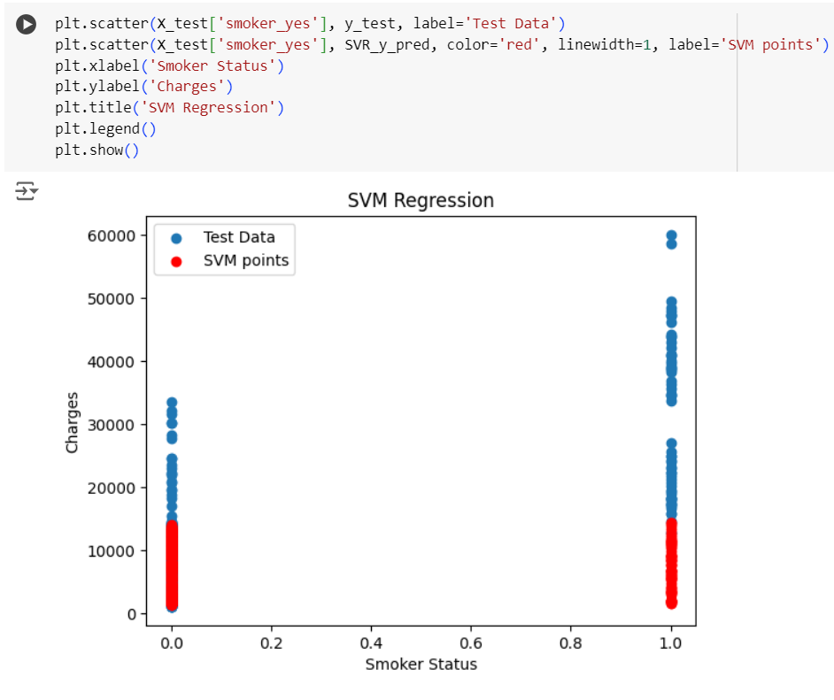

Slide 56
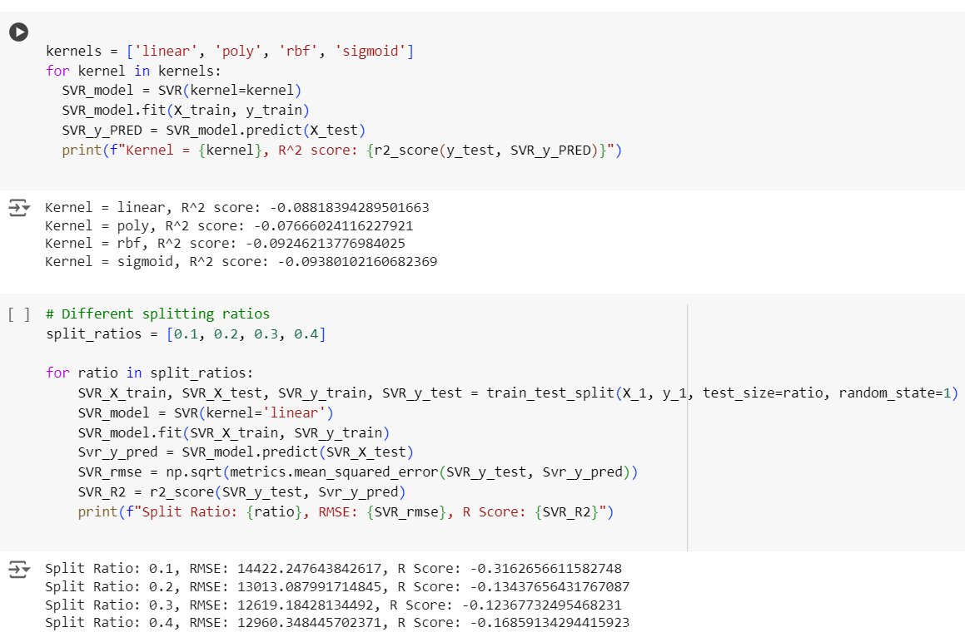

Slide 57
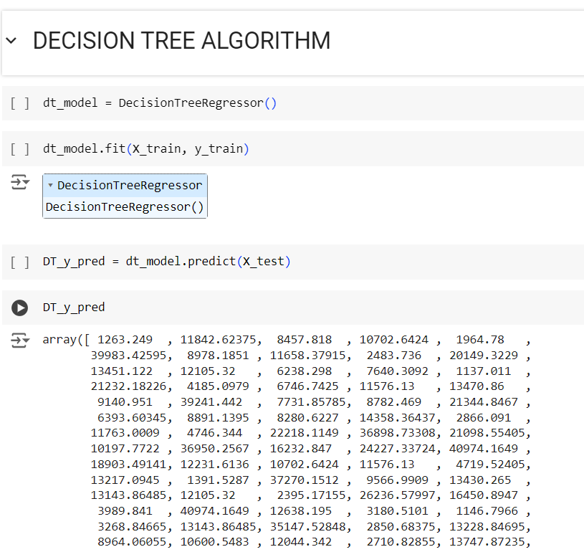
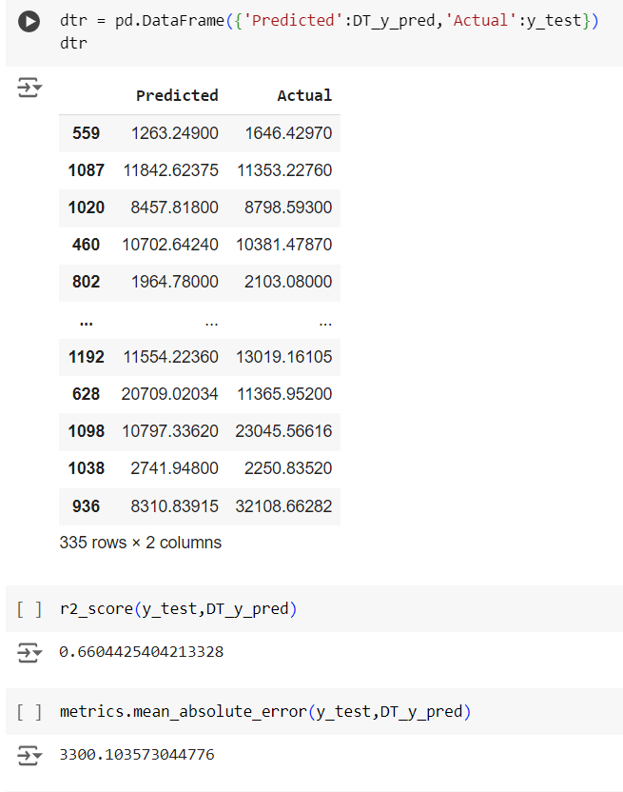

Slide 58
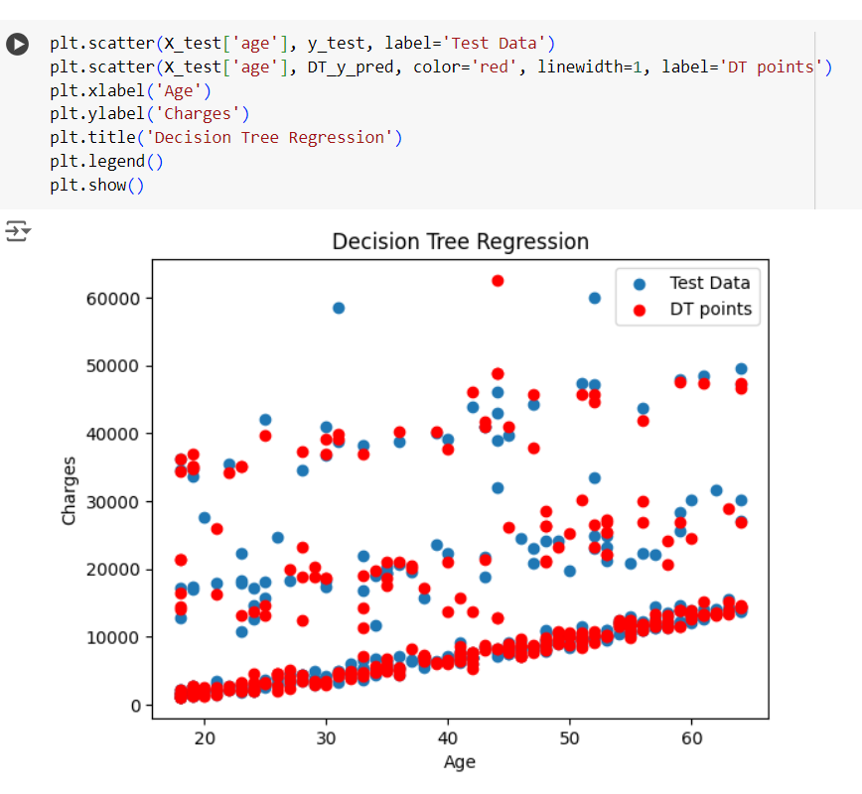
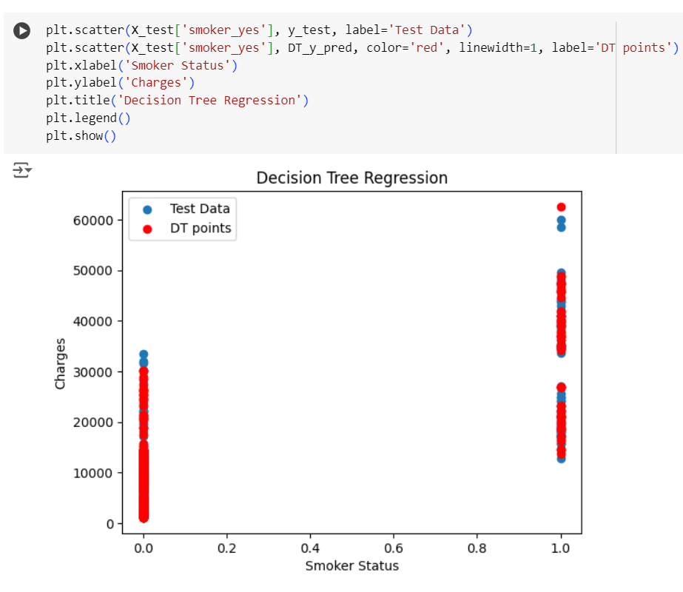

Slide 59
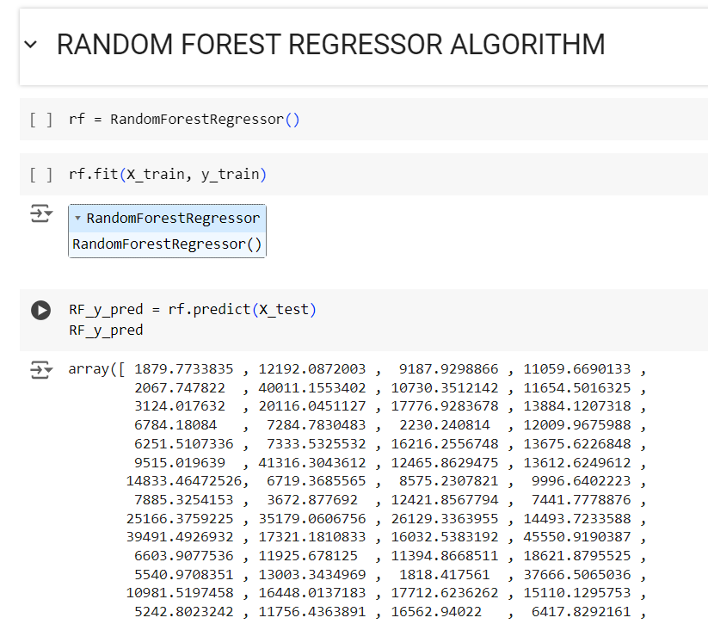


Slide 60



Slide 61



Slide 62



Slide 63



